Slide 1
Minimal Cycle Representatives in Persistent Homology using Linear Programming
Lori Ziegelmeier
Macalester College
Topological Data Visualization Workshop
University of Iowa
June 11, 2025

Slide 2
Motivation

Slide 3
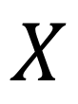
Data
(in the form of a topological space)
$$X$$

Slide 4

Cycle representative
(of a homology class)
$$A$$
$$X$$
Notes:
Cycle representative = generator

Slide 5

Cycle representative
(of a different homology class)
$$B$$
$$X$$
Notes:
non-uniqueness of these representatives creates ambiguity and can lead to many different interpretations of the same set of classes.

Slide 6


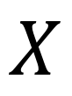
$$B$$
$$B^{′}$$
$$X$$
A tighter representative
Notes:
Often want to find a cycle that captures not only the existence but also information about the location and shape of the hole that the homology class has detected.

Slide 7
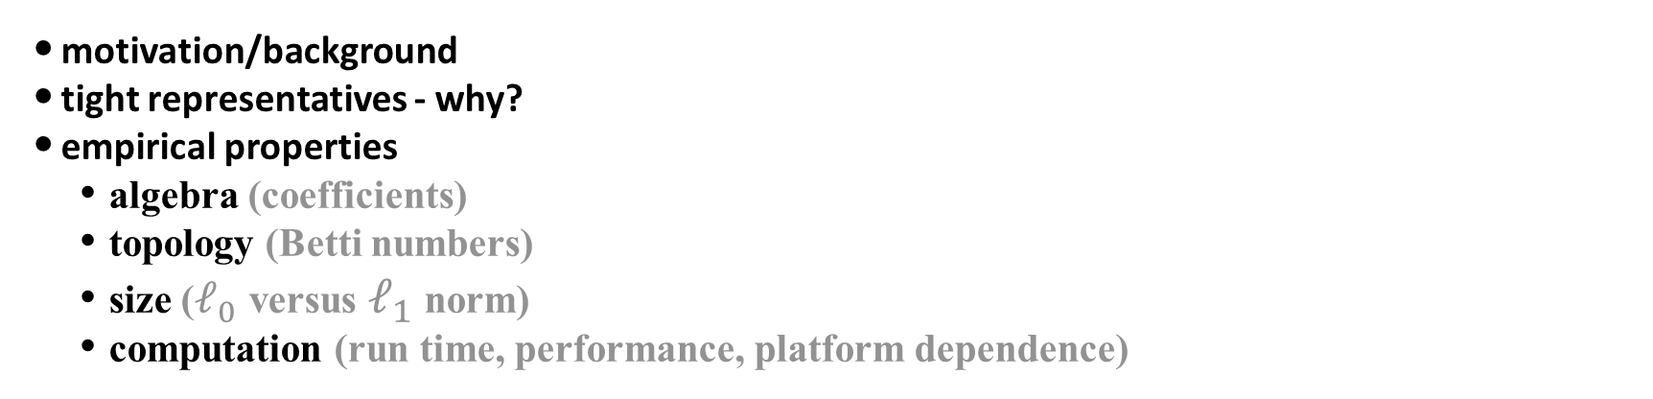
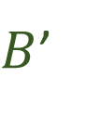

$$B$$
$B$’
PLAN
motivation/background
tight representatives - why?
empirical properties
algebra (coefficients)
topology (Betti numbers)
size ($ℓ_{0}$ versus $ℓ_{1}$ norm)
computation (run time, performance, platform dependence)
Notes:
Betti numbers: how often does the support of a representative form a single loop in the underlying graph

Slide 8
Background

Slide 9
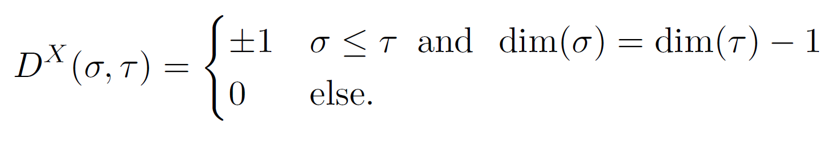
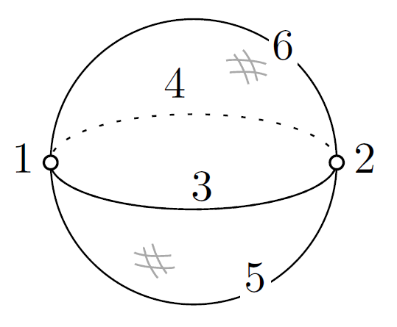
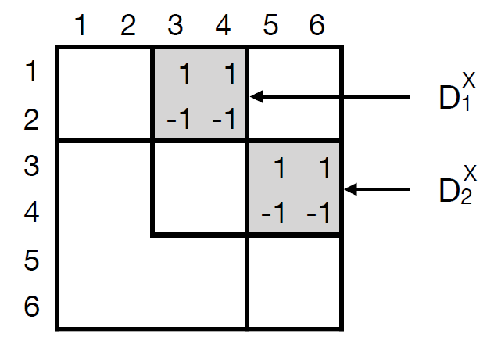
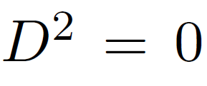
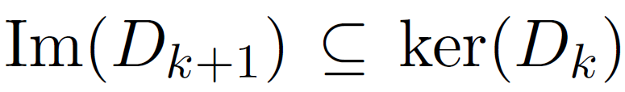
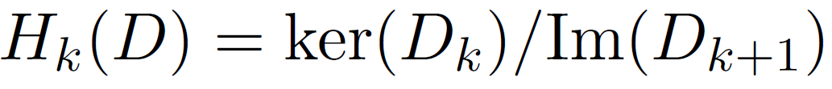
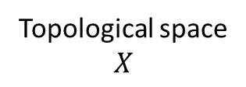
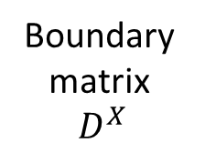
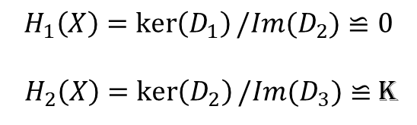

motivation: finding loops in a topological space
What is homology?
$$\{$$
Topological space
$$X$$
Since
Boundary
matrix
$$D^{X}$$
B_{k} := k-boundaries
Z_{k} := k-cycles
And Homology
= k-cycles / k-boundaries
$$H_{1}\left(X\right)=\ker\left(D_{1}\right)/Im(D_{2})≌0$$
${ H}_{2}\left(X\right)=\ker\left(D_{2}\right)/Im(D_{3})≌$ K
choice of field
Notes:
Example: 2-sphere decomposition as a CW complex as a union of points, lines, disks, balls. This complex has two 0-cells (labeled 1 and 2), two 1-cells (labeled 3 and 4), and two 2-cells (labeled 5 and 6).
The signs of the nonzero coefficients in this formula are determined as an alternating sum of a cell’s boundary elements.
Every boundary matrix represents a chain complex.
Elements of H_n(K) are cosets, and a cycle can represent the coset

Slide 10
motivation: mimic the mind’s eye with a union of balls
What is persistent homology?
what you see
what you construe
what you tell your computer

Slide 11
What is persistent homology?
problem: topology depends on choice of radius
radius = 0
radius = 0.5
radius = 1

Slide 12







$$\{$$
$$B$$
nested
sequence
of spaces
$$A$$
radius
$$0$$
$$\{$$
lifespan of
$$B$$
barcode
lifespan of
$$A$$
more “robust”

Slide 13
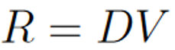
motivation: matrix decomposition
How to compute persistence?
R, “reduced”, every nonzero column has lowest entry in distinct row
V, invertible &
upper triangular
Anti-transpose of boundary matrix
Standard Algorithm
Cohomology Algorithm
Same barcode, different cycle representatives
V. De Silva, D. Morozov, and M. Vejdemo-Johansson. “Dualities in persistent (co)homology.” 2011 https://arxiv.org/abs/1107.5665
Notes:
Compute R=DV, where V is an upper triangular matrix and obeys sparsity conditions
Cohomology algorithm is applied to antitranspose (transpose matrix and then switch rows and columns) of the boundary matrix.
Standard and cohomology algorithms give same barcodes (based on duality of vector spaces) but latter (which is generally faster) does not give homology representatives

Slide 14
Some Tasks we Might Like to Perform
Given a vector b, solve Dx = b
Calculate a row or column of R and V
Identify the lowest nonzero element in each nonzero column of R
Compute a basis for the image of the filtration under the linear map D
Compute a cycle representative for a specific bar in the persistent homology barcode
Compute a cocycle representative for a specific bar in the persistent cohomology barcode
Notes:
In practice, the boundary matrix D of a cell complex often has millions or billions of columns and rows. This is given as input we need to store, but can we perform relevant operations without storing much else?

Slide 15
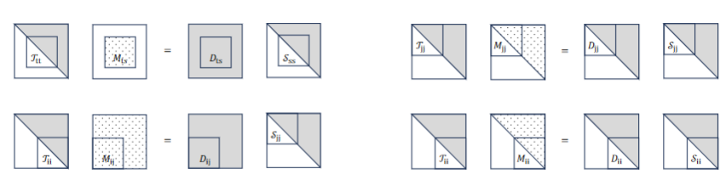
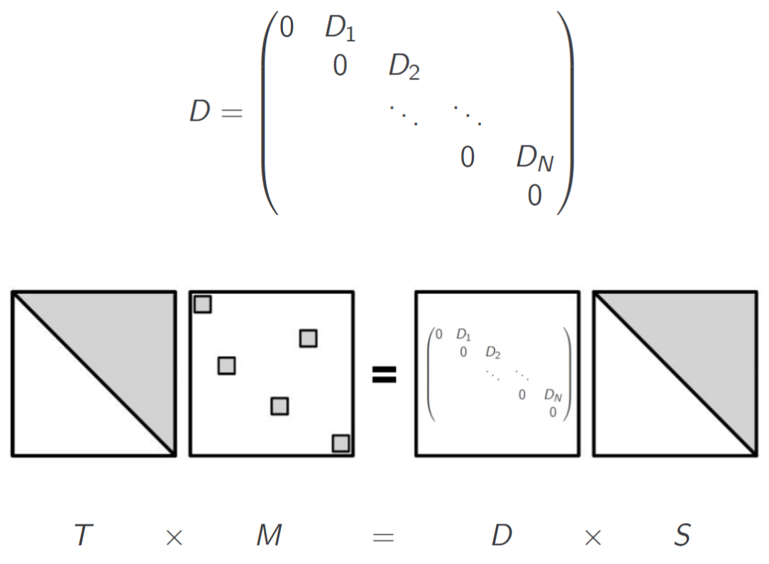
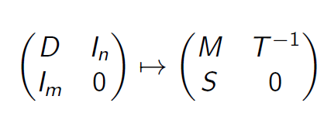
U-Match Factorization
Target
Matching Matrix
Boundary Matrix
Source
Notes:
S (source) and T (target) uni upper triangular
M is a matching matrix with at most one 1 in each row or column
Left multiplication with D sends each column of S either to 0 (if column of M is 0) or to a column of T
U-match not unique but exists for any matrix
Do row reduction on D bottom to top and left to right, S records column operations and T^(-1) records row operations.
Columns of S indexed by the set of zero columns of M contain a basis for Ker(D), the cycles
Columns of T indexed by the set of non-zero rows (pivot entries) in M give a basis for Im(D) which are the boundaries
U-match “matches” the bases for the cycles and boundaries
U-Match decomposition in 1-1 correspondence with R=DV (V is S in U-match) or V in cohomology decomposition is related to T, by storing inner identities (pivot indices in matrix T^(-1)) can construct arbitrary rows and columns
All previous tasks mentioned essentially only involve look-up of particular rows/columns of T, S, T^(-1), S^(-1)

Slide 16

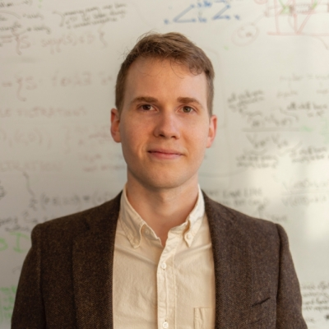
Collaborators:
Haibin Hang Greg Henselman-Petrusek Chad Giusti
Amazon Pacific Northwest National Lab Oregon State
H. Hang, C. Giusti, L. Ziegelmeier, and G. Henselman-Petrusek. “U-match factorization: sparse homological algebra, lazy cycle representatives, and dualities in persistent (co)homology.” 2021, https://arxiv.org/pdf/2108.08831.pdf

Slide 17
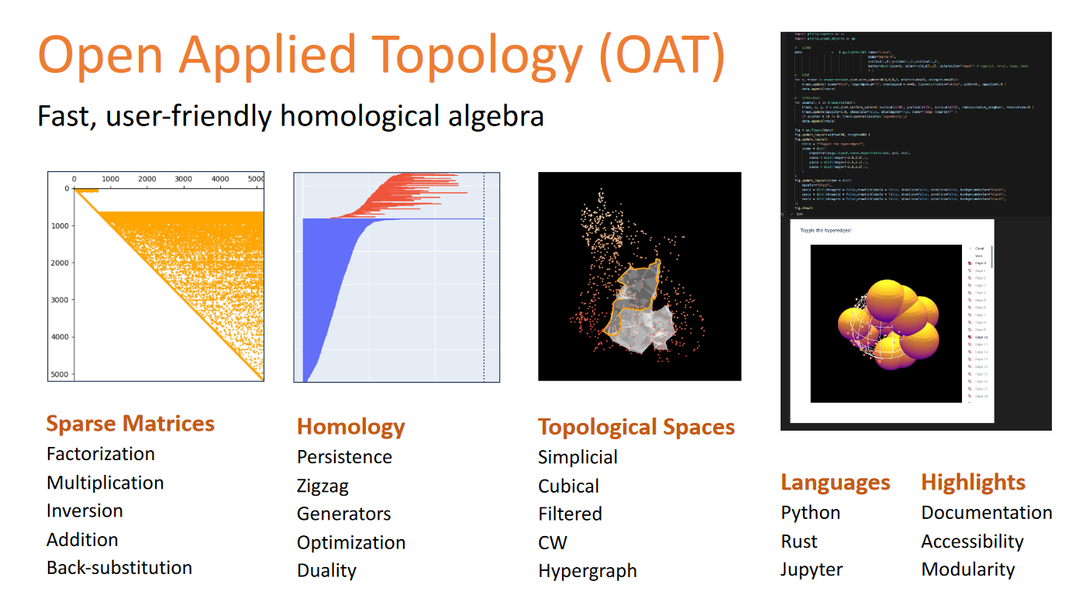
http://OpenAppliedTopology.github.io OAT
Notes:
OAT is a computational toolset leveraging sparse and lazy computational methods to directly analyze high-dimensional data’s topological structure, enabling the study and localization of geometric patterns within datasets.

Slide 18
Example Filtration

Slide 19
A B C D E F G
AC
BC
A
B
G
C
F
D
E

Slide 20
A B C D E F G
AC
BC
A
B
G
C
F
D
E

Slide 21
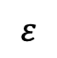
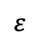
A B C D E F G
A
$$ε$$
AC
BC
AB
EF
FG
B
$$ε$$
G
C
F
D
E

Slide 22
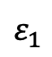
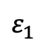
A B C D E F G
A
AC
BC
$$ε_{1}$$
AB
EF
FG
B
$$ε_{1}$$
G
ABC
C
F
D
E

Slide 23
A B C D E F G
A
AC
BC
AB
EF
FG
B
G
ABC
C
AG
BD
F
D
E

Slide 24
A B C D E F G
A
AC
BC
AB
EF
FG
B
G
ABC
C
AG
BD
DE
F
D
E

Slide 25
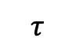
A B C D E F G
A
AC
BC
AB
EF
FG
B
G
ABC
C
AG
BD
DE
F
D
$$τ$$
E

Slide 26
A B C D E F G
A
AC
BC
AB
EF
FG
B
G
ABC
C
AG
BD
DE
F
D
$$τ$$
E

Slide 27
A B C D E F G
A
AC
BC
AB
EF
FG
B
G
ABC
C
AG
BD
DE
CD
F
D
$$τ$$
E

Slide 28
A B C D E F G
A
AC
BC
AB
EF
FG
B
G
ABC
C
AG
BD
DE
CD
F
BCD
D
E

Slide 29
A B C D E F G
A
AC
BC
AB
EF
FG
B
G
ABC
C
AG
BD
DE
CD
BCD
GC
F
D
E

Slide 30
A B C D E F G
A
AC
BC
AB
EF
FG
B
G
ABC
C
AG
BD
DE
CD
BCD
GC
F
D
ACG
E

Slide 31
A B C D E F G
A
AC
BC
AB
EF
FG
B
G
ABC
C
AG
BD
DE
CD
BCD
GC
F
ACG
D
CE
E

Slide 32
A B C D E F G
A
AC
BC
AB
EF
FG
B
G
ABC
C
AG
BD
DE
CD
BCD
GC
F
ACG
D
CE
CED
E

Slide 33
A B C D E F G
A
AC
BC
AB
EF
FG
B
G
ABC
C
AG
BD
DE
CD
BCD
GC
F
ACG
D
CE
CED
CF
E

Slide 34
A B C D E F G
A
AC
BC
AB
EF
FG
B
G
ABC
C
AG
BD
DE
CD
BCD
GC
F
ACG
D
CE
CED
CF
E
CEF
CFG

Slide 35
A B C D E F G
A
AC
BC
AB
EF
FG
B
G
ABC
C
AG
BD
DE
CD
BCD
GC
F
ACG
D
CE
CED
CF
E
CEF
CFG

Slide 36
A B C D E F G
A
AC
BC
AB
EF
FG
B
G
ABC
C
AG
BD
DE
CD
BCD
GC
F
ACG
D
CE
CED
CF
E
CEF
CFG

Slide 37
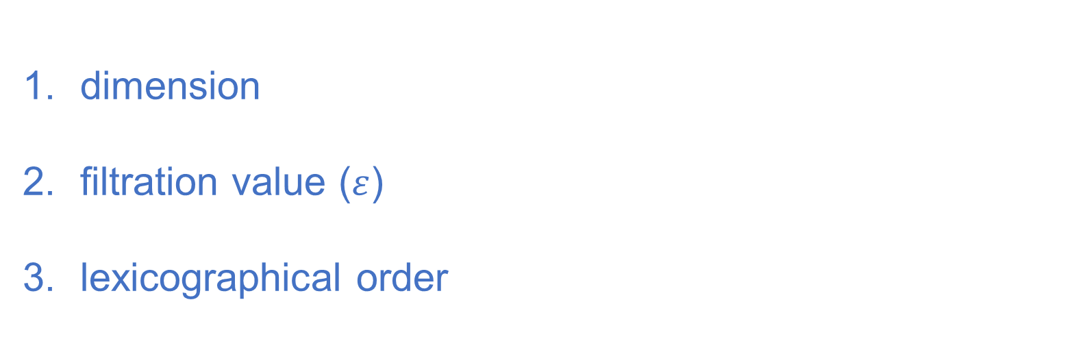
A B C D E F G
dim = 0
Simplex-wise Filtration
AC
BC
AB
EF
FG
dimension
filtration value ($ε$)
lexicographical order
AG
BD
dim = 1
DE
CD
GC
CE
CF
ABC
BCD
ACG
dim = 2
CED
CEF
CFG

Slide 38
Minimal Cycle Representatives

Slide 39

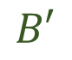
When do “good” cycle representatives matter?
Would you prefer B or B'?
you need to locate a feature in some data
you need to visualize a topological feature
you prefer smooth curves
geometry matters
$$B′$$
$$B$$
Notes:
Localizing homology classes can be characterized as finding a representative cycle with the most concise geometric measure
Used to segment cardiac tissues or analyze chromatin interactions

Slide 40
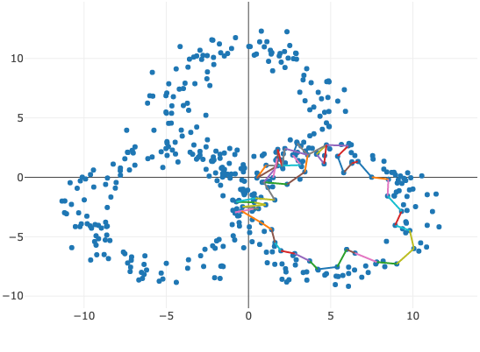
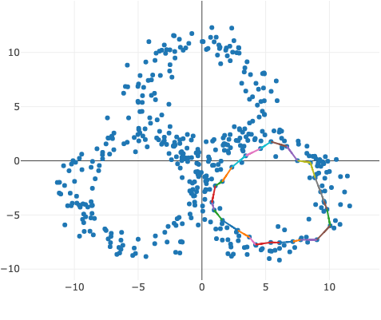
What makes a cycle representative “good”?

Slide 41
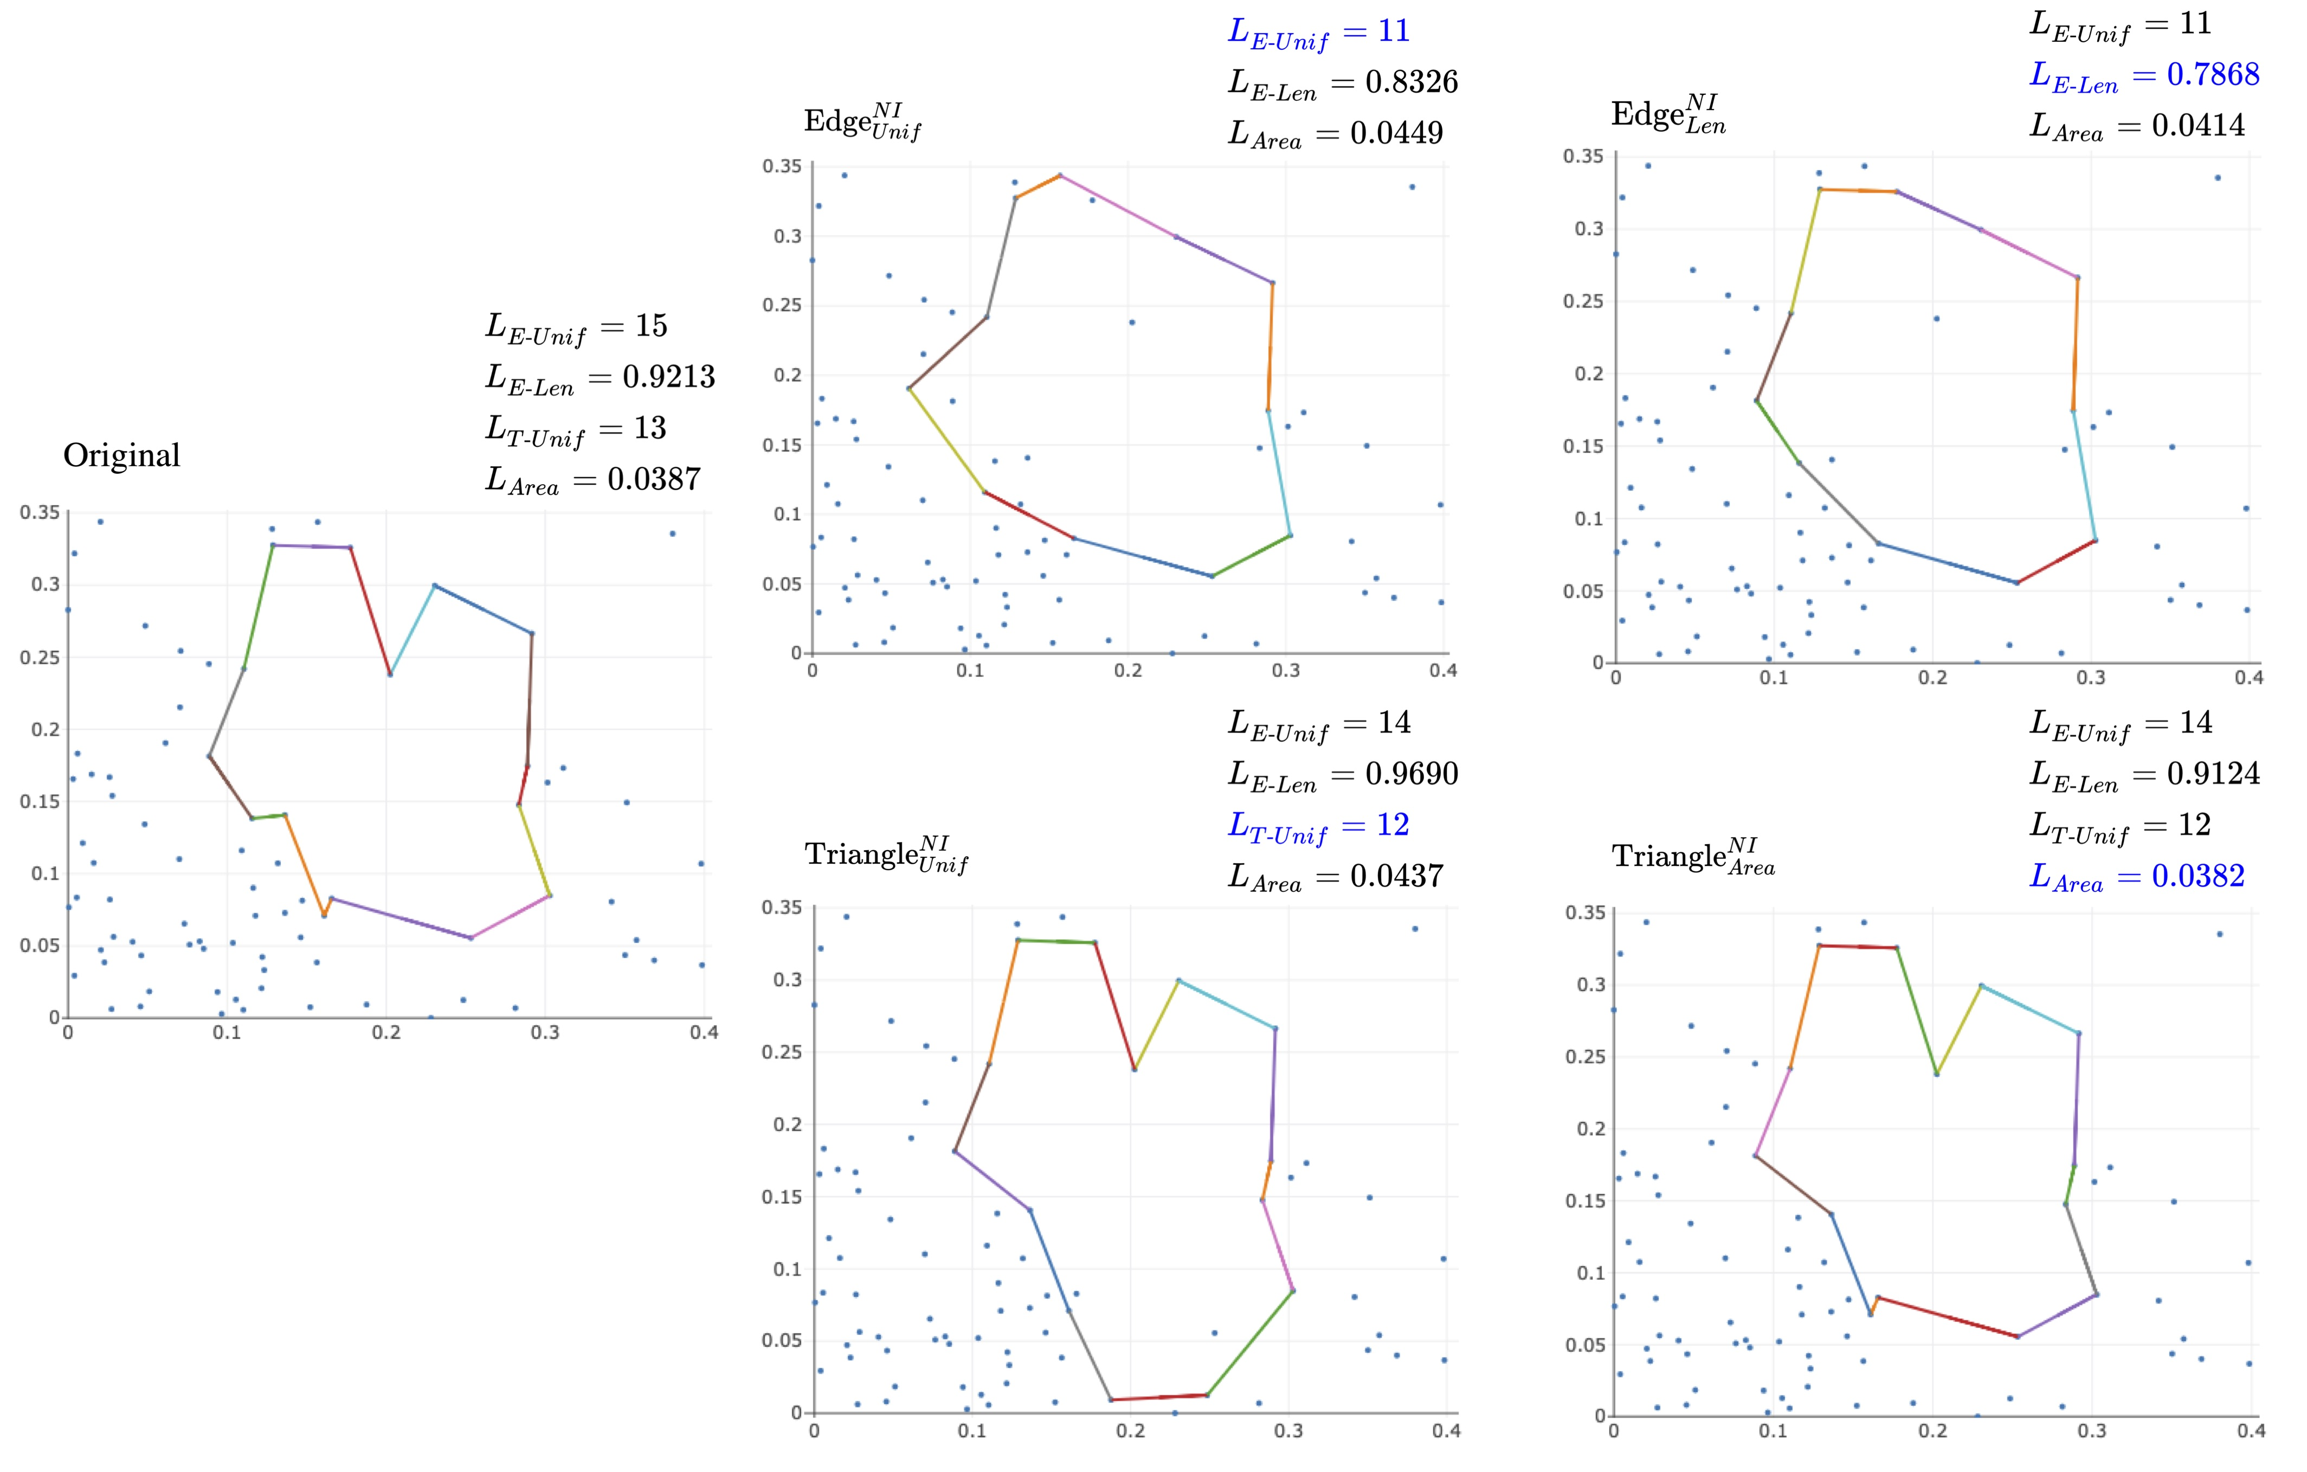


Example
REPRESENTATIVE
FOR A SINGLE BAR
POINT CLOUD
FILTRATION
BARCODE
$$xorig$$
$$v$$

Slide 42
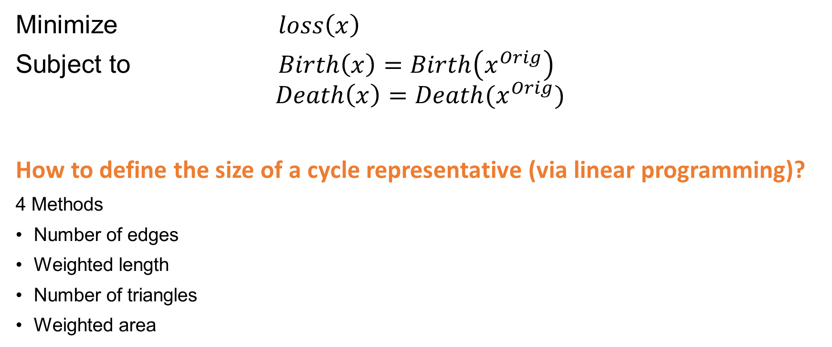
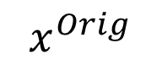
Minimizing a Persistent Cycle Representative
dimension-1
?
Minimize $loss\left(x\right)$
Subject to $Birth\left(x\right)=Birth\left(x^{Orig}\right)$
$$Death\left(x\right)=Death(x^{Orig})$$
How to define the size of a cycle representative (via linear programming)?
4 Methods
Number of edges
Weighted length
Number of triangles
Weighted area
$$x^{Orig}$$
Related papers
E. Escolar and Y. Hiraoka. "Optimal cycles for persistent homology via linear programming." Optimization in the Real World. Springer, Tokyo, 2016. 79-96.
I. Obayashi. "Volume-optimal cycle: Tightest representative cycle of a generator in persistent homology." SIAM Journal on Applied Algebra and Geometry 2.4 (2018): 508-534.
Notes:
Other approaches: Wu, Chen, Dey graph based using A* heuristic or Dijkstra’s algorithm or fitting cycle representatives within a ball of minimum radius

Slide 43
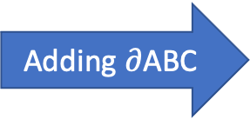
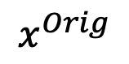
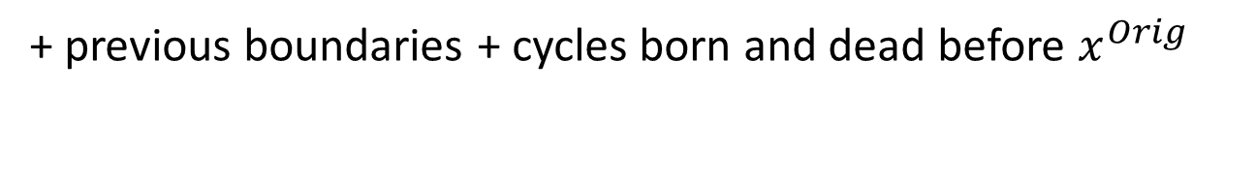
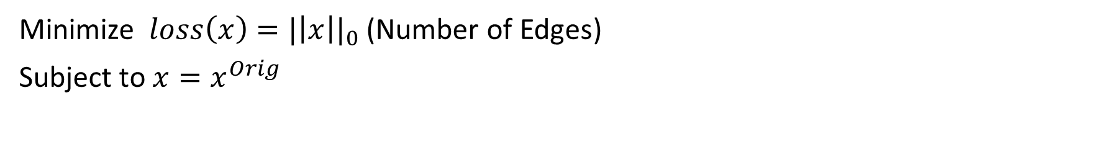
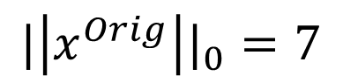
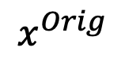
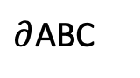
Minimize Number of Edges
Minimize $loss\left(x\right)={|\left|x\right||}_{0}$ (Number of Edges)
Subject to $x=x^{Orig}$
+ previous boundaries + cycles born and dead before $x^{Orig}$
Adding $∂$ABC
A
A
$$x^{Orig}$$
B
$$x^{Orig}$$
$∂$ABC
B
G
G
AC
BC
1
-1
0
1
1
1
1
1
0
0
0
-1
1
1
0
0
0
0
0
0
0
0
C
C
AB
EF
FG
AG
BD
DE
CD
+
F
F
D
D
GC
$${|\left|x^{Orig}\right||}_{0}=7$$
CE
E
CF
E
Notes:
Similar to algorithm in Escolar and Hiraoka. Sum of cycles born before factors out redundant cycles, but they did not include they must also die before.
x need not be homologous to x^orig
Dey et al. (2011) propose an algorithm to find an optimal homologous 1-cycle for a given homology class via linear programming. That is, they consider a single homology class [x] and search for a homologous cycle representative that minimizes some geometric measure within that class, for instance, the number of 1-simplices within the representative. Escolar and Hiraoka (2016) extend this approach to find an optimal cycle by using cycles outside of a single homology class to “factor out” redundant information. In this approach, an optimal cycle representative is no longer guaranteed to be homologous to the original representative, but the collection of cycle representatives have each been independently optimized and the collection still forms a homology basis.

Slide 44
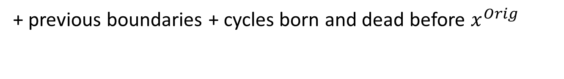
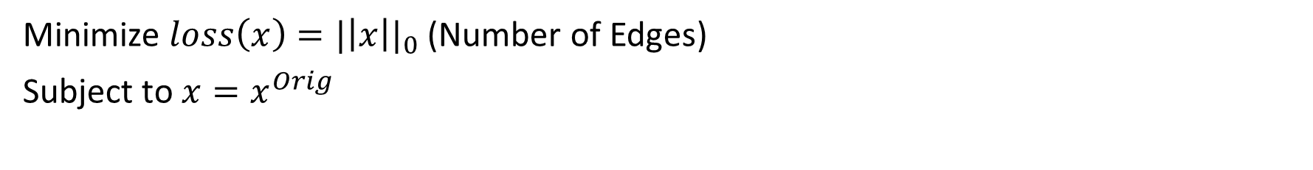
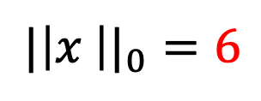
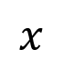
Minimize Number of Edges
Minimize $loss\left(x\right)={|\left|x\right||}_{0}$ (Number of Edges)
Subject to $x=x^{Orig}$
+ previous boundaries + cycles born and dead before $x^{Orig}$
Adding $∂$ABC
A
A
$$x^{Orig}$$
B
$$x^{Orig}$$
$∂$ABC
$$x$$
B
G
G
AC
BC
1
-1
0
1
1
1
1
1
0
0
0
-1
1
1
0
0
0
0
0
0
0
0
0
0
1
1
1
1
1
1
0
0
0
C
C
AB
EF
FG
AG
BD
DE
CD
+
=
F
F
D
D
GC
$${|\left|x \right||}_{0}=6$$
CE
E
CF
E

Slide 45
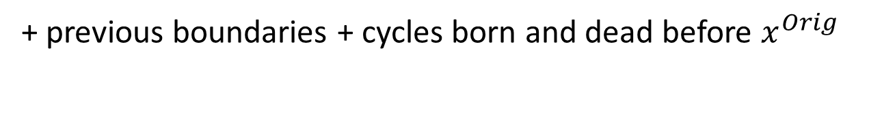
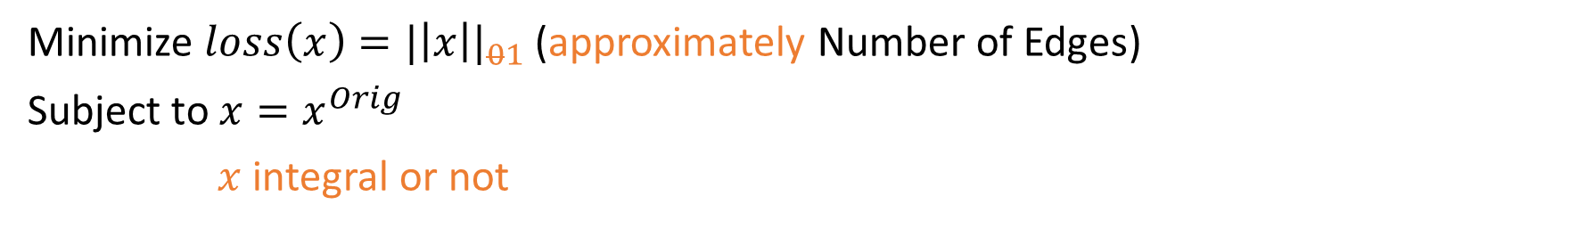
Minimize Number of Edges
Minimize $loss\left(x\right)={|\left|x\right||}_{01}$ (approximately Number of Edges)
Subject to $x=x^{Orig}$
$x$ integral or not
+ previous boundaries + cycles born and dead before $x^{Orig}$
Adding $∂$ABC
A
A
$$x^{Orig}$$
B
$$x^{Orig}$$
$∂$ABC
$$x$$
B
G
G
AC
BC
1
-1
0
1
1
1
1
1
0
0
0
-1
1
1
0
0
0
0
0
0
0
0
0
0
1
1
1
1
1
1
0
0
0
C
C
AB
EF
FG
AG
BD
DE
CD
+
=
F
F
D
D
GC
$${|\left|x \right||}_{0}=6$$
CE
E
CF
E
Notes:
An objective function with l_0 is highly interpretable, but NP-hard to compute. L_1 norm often gives a good approximation of the l_0 norm. If result has coefficients in 0,-1,1, then l_0 and l_1 are identical. A looser restriction would be to solve l_1 objective function with integer constraints.
Dey gives totally unimodularity sufficient condition which guarantees when an LP and MIP give the same optimal solution (determinant of each square submatrix of d_{n+1} is -1,0,or 1). Often does not happen in practice.

Slide 46
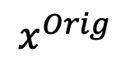
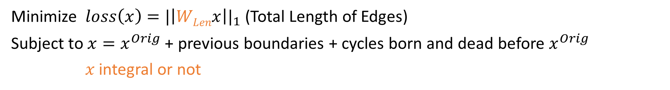
Weighted Length of Edges
Minimize $loss\left(x\right)={|\left|WLenx\right||}_{1}$ (Total Length of Edges)
Subject to $x=x^{Orig}$ + previous boundaries + cycles born and dead before $x^{Orig}$
$x$ integral or not
A
A
A
$$x^{Orig}$$
B
B
B
G
G
G
C
C
C
F
F
F
D
D
D
E
E

Slide 47
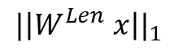
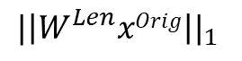
A
A
B
B
G
G
C
C
F
F
D
D
E
E
${|\left|W^{Len}xOrig\right||}_{1}$
${|\left|W^{Len} x\right||}_{1}$

Slide 48
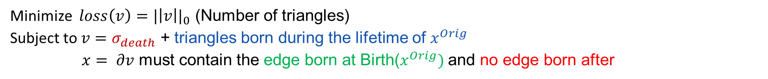
Number of Triangles (a cycle bounds)
Minimize $loss\left(v\right)={|\left|v\right||}_{0}$ (Number of triangles)
Subject to $v=σ_{death}$ + triangles born during the lifetime of $x^{Orig}$
$x= ∂v$ must contain the edge born at Birth($x^{Orig})$ and no edge born after

Slide 49
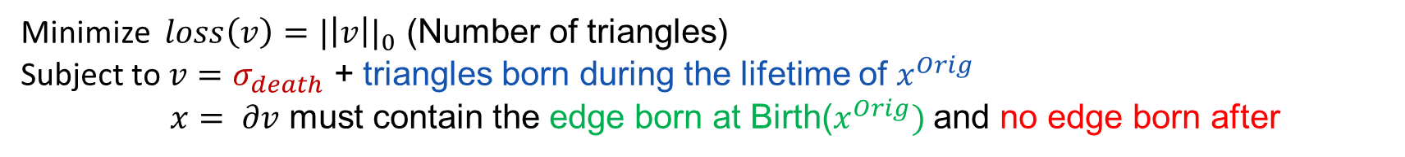
Number of Triangles (a cycle bounds)
AC
BC
Minimize $loss\left(v\right)={|\left|v\right||}_{0}$ (Number of triangles)
Subject to $v=σ_{death}$ + triangles born during the lifetime of $x^{Orig}$
$x= ∂v$ must contain the edge born at Birth($x^{Orig})$ and no edge born after
AB
EF
FG
AG
BD
DE
CD
GC
CE
CF
ABC
BCD
ACG
CED
CEF
CFG
Notes:
Method of Obayashi, but adapted to work with Vietoris-Rips complexes
Needs a simplex-wise filtration

Slide 50



Number of Triangles (a cycle bounds)
AC
BC
Minimize $loss\left(v\right)={|\left|v\right||}_{0}$ (Number of triangles)
Subject to $v=σ_{death}$ + triangles born during the lifetime of $x^{Orig}$
$x= ∂v$ must contain the edge born at Birth($x^{Orig})$ and no edge born after
AB
EF
FG
AG
BD
DE
CD
G
GC
C
CE
CF
ABC
BCD
ACG
F
CED
CEF

Slide 51

Number of Triangles (a cycle bounds)
AC
BC
Minimize $loss\left(v\right)={|\left|v\right||}_{0}$ (Number of triangles)
Subject to $v=σ_{death}$ + triangles born during the lifetime of $x^{Orig}$
$x= ∂v$ must contain the edge born at Birth($x^{Orig})$ and no edge born after
AB
EF
FG
AG
BD
DE
CD
G
GC
C
CE
CF
ABC
BCD
ACG
F
CED
E

Slide 52

Number of Triangles (a cycle bounds)
Minimize $loss\left(v\right)={|\left|v\right||}_{0}$ (Number of triangles)
Subject to $v=σ_{death}$ + triangles born during the lifetime of $x^{Orig}$
$x= ∂v$ must contain the edge born at Birth($x^{Orig})$ and no edge born after
AC
BC
AB
EF
FG
A
AG
BD
DE
CD
G
GC
C
CE
CF
ABC
BCD
F
CED
E

Slide 53

Number of Triangles (a cycle bounds)
AC
BC
Minimize $loss\left(v\right)={|\left|v\right||}_{0}$ (Number of triangles)
Subject to $v=σ_{death}$ + triangles born during the lifetime of $x^{Orig}$
$x= ∂v$ must contain the edge born at Birth($x^{Orig})$ and no edge born after
AB
EF
FG
A
AG
BD
DE
CD
G
GC
C
CE
CF
ABC
BCD
F
D
E

Slide 54

Number of Triangles (a cycle bounds)
AC
BC
Minimize $loss\left(v\right)={|\left|v\right||}_{0}$ (Number of triangles)
Subject to $v=σ_{death}$ + triangles born during the lifetime of $x^{Orig}$
$x= ∂v$ must contain the edge born at Birth($x^{Orig})$ and no edge born after
AB
EF
FG
A
AG
BD
DE
CD
B
G
GC
C
CE
CF
ABC
F
D
E

Slide 55


Number of Triangles (a cycle bounds)
AC
BC
$$x^{Orig} not needed!$$
Minimize $loss\left(v\right)={|\left|v\right||}_{0}$ (Number of triangles)
Subject to $v=σ_{death}$ + triangles born during the lifetime of $x^{Orig}$
$x= ∂v$ must contain the edge born at Birth($x^{Orig})$ and no edge born after
AB
EF
FG
A
AG
BD
DE
CD
B
G
GC
C
CE
CF
ABC
BCD
ACG
F
D
CED
CEF
E
CFG

Slide 56

Number of Triangles (a cycle bounds)
AC
BC
Minimize $loss\left(v\right)={|\left|v\right||}_{01}$ (approximately Number of triangles)
Subject to $v=σ_{death}$ + triangles born during the lifetime of $x^{Orig}$
$x= ∂v$ must contain the edge born at Birth($x^{Orig})$ and no edge born after
$v$ integral or not
AB
EF
FG
A
AG
BD
DE
CD
B
G
GC
C
CE
CF
ABC
BCD
ACG
F
D
CED
CEF
E
CFG

Slide 57
Edge-loss
A
Triangle-loss
A
B
B
G
G
C
C
F
D
F
D
E
E
6 Edges
6 Triangles
7 Edges
5 Triangles

Slide 58

Weighted Area of Triangles (a cycle bounds)
AC
BC
Minimize $loss\left(v\right)={|\left|WAreav\right||}_{1}$ (Area of triangles)
Subject to $v=σ_{death}$+ triangles born during the lifetime of $x^{Orig}$
$x= ∂v$ must contain the edge born at Birth($x^{Orig})$ and no edge born after
$v$ integral or not
AB
EF
FG
A
AG
BD
DE
CD
B
G
GC
C
CE
CF
ABC
BCD
ACG
F
D
CED
CEF
E
CFG
Notes:
Use Heron’s algorithm to find the area of a 2-simplex (triangle)

Slide 59



A Note About Linear Programming
Linear Programs are of the form:
Mixed Integer Programs are of the form:
minimize $c^{T}x$
subject to $Ax=b$
$x≥0$
minimize $c^{T}x+d^{T}y$
subject to $Ax+By=b$
$x,y≥0$
$x$ integer
Fewer constraints,
Convex optimization
More constraints,
Discrete problem
All programs discussed can be written in the form:
minimize ${ |\left|Wx\right||}_{1}=\sum_{σ}{W[σ,σ]}{(x}^{+}+x^{− })$
subject to $x=x^{+}−x^{− }$
$x^{+}$, $x^{−}$≥ 0
$x∈$1 or 2 chains, integral or not
Notes:
LP solved with simplex algorithm (exponential but often runs fast) or interior point methods (polynomial time). No general algorithm is known to solve MIPs, although LP relaxations, polynomial-time approximation, exponential time exact, and heuristic algorithms can be used to obtain solutions to MIPs.
X=1-chains or 2-chains, integral or not

Slide 60









Summary
REPRESENTATIVE
FOR A SINGLE BAR
POINT CLOUD
FILTRATION
BARCODE
$$xorig$$
FOUR OBJECTIVE FUNCTIONS
$$\#\text{edges}≈∥x∥_{1}$$
$$∑(\text{edge} \text{lengths})≈∥WLenx∥_{\begin{aligned}1 \\ \\ \end{aligned}}$$
$$\#\text{tr}iangles≈∥v∥_{1}$$
$$∑\left(\text{triangle} \text{areas}\right)≈∥WAreav∥_{1}$$
EIGHT OPTIMIZATION PROBLEMS
$$\begin{matrix}\text{mimimize} & Loss(x) \\ \text{subject} \text{to} & x\text{represents} \text{the} \text{same} \text{bar} \text{as} xorig\end{matrix}$$
$x$ integral or not
$$v$$
$$\begin{matrix}\text{mimimize} & Loss(v) \\ \text{subject} \text{to} & x=∂v \text{represents} \text{the} \text{same} \text{bar} \text{as} xorig\end{matrix}$$
$v$ integral or not

Slide 61




Example
Solutions to unweighted problems often non-unique
# edges
$$∥WLen{x∥}_{1}≈∑(\text{edge} \text{lengths})$$
sum of edge
lengths
$$∥x∥_{1}≈\#\text{edges}$$
Unif loss functions use actual 0-norm
$$∥v∥_{1}≈\#\text{triangles}$$
$$∥WAreav∥_{1}≈∑(\text{triangle} \text{areas})$$
sum of (bounding) triangle areas
# bounding
triangles
Notes:
Examples of different optimal cycles and cost against different loss functions using a point cloud of 100 points with ambient dimension 2 randomly drawn from a normal distribution. The upper left corner of each subfigure labels the optimization algorithm used to optimize the original cycle representative. The upper right corner of each subfigure records the different measures of the size of the optimal representative. Blue text represents the measure an algorithm sets out to optimize.

Slide 62










Empirical Study of Minimal Cycle Representatives
Loss = $ℓ_{0}$ norm
Loss = length weighted $ℓ_{0}$ norm
$$\frac{Loss(x^{opt})}{Loss(x^{orig})}$$
$$Loss(x^{orig})$$
$$Loss(x^{orig})$$
Notes:
Computation time can be up to 30 times longer for GLPK than Gurobi. Different solvers can lead to different coefficients.
T_Tri > T_Edge for representatives with a longer persistence, boundary matrix much larger in triangle than edge-loss but triangle-loss less for shorter persistence intervals
T^I > T^NI but on same order of magnitude, only substantially different for very short LP time. Typically give exact same solutions.

Slide 63



Collaborators:
Lu Li Connor Thompson Qingru Zhang
U Penn Purdue Google
Paper
Minimal Cycle Representatives in Persistent Homology using Linear Programming: an Empirical Study with User’s Guide
https://arxiv.org/pdf/2105.07025.pdf
https://www.frontiersin.org/articles/10.3389/frai.2021.681117/full
Code
https://github.com/TDAMinimalGeneratorResearch/minimal-generator
https://github.com/UDATG/optimal_reps
http://OpenAppliedTopology.github.io OAT
Related papers
I. Obayashi. "Volume-optimal cycle: Tightest representative cycle of a generator in persistent homology." SIAM Journal on Applied Algebra and Geometry 2.4 (2018): 508-534.
E. Escolar and Y. Hiraoka. "Optimal cycles for persistent homology via linear programming." Optimization in the Real World. Springer, Tokyo, 2016. 79-96.
H. Hang, C. Giusti, L. Ziegelmeier, and G. Henselman-Petrusek. “U-match factorization: sparse homological algebra, lazy cycle representatives, and dualities in persistent (co)homology.” 2021, https://arxiv.org/pdf/2108.08831.pdf
C. Giusti, C. Henselman-Petrusek, and L. Ziegelmeier. “The basis matching complex: a streamlined framework for persistent homological algebra,” forthcoming.
Notes:
OAT is a platform that lets people do calculations they can’t do already by giving a nice clean way to get access to and work with sparse matrices.
Computing generators "basic first step / proof of concept" and to show that we are providing basic building blocks that people will want to play with.
Basis matching complex for a filtered chain complex
(overview of the relationship between cycle representatives, change of basis matrices, and matrix factorization)

Slide 64
Knowledge Networks

Slide 65

How has science progressed through time?
The Science of Science studies the development of science itself
Science can be conceptualized as a network of scientific concepts

Slide 66

Knowledge Network
Science can be conceptualized as a network of concepts
Nodes: Scientific concepts
Edges: Connect two concepts that appear in the same paper
Edge weights: a normalized year
(t* - t_min)/(t_max - t_min)
t*: the first year when two nodes appear in an abstract of a paper
t_min: minimum year among all papers
t_max: maximum year among all papers
“Progress” is the addition of new concepts or of new connections among them
Holes can be inferred as “knowledge gaps”
Connections that fill holes or span gaps are particularly associated with innovation
Notes:
Concepts are noun-phrases

Slide 67

Knowledge Network
Science can be conceptualized as a network of concepts
Nodes: Scientific concepts
Edges: Connect two concepts that appear in the same paper
Edge weights: a normalized year
(t* - t_min)/(t_max - t_min)
t*: the first year when two nodes appear in an abstract of a paper
t_min: minimum year among all papers
t_max: maximum year among all papers
“Progress” is the addition of new concepts or of new connections among them
Holes can be inferred as “knowledge gaps”
Connections that fill holes or span gaps are particularly associated with innovation
Notes:
Concepts are noun-phrases

Slide 68

Knowledge Networks Through Time
Goals:
Identify holes of varying complexity (dimensionality)
Identify their opening, closing, and duration
Characterize the papers and concepts that bound them
Represent and compare longitudinally and cross-sectionally
Notes:
Higher-order structure as opposed to dyads and network science tools like community detection and centrality
Work in SciSci generally compares
realized networks to random or model generated counterfactuals because there is little a priori reason
to assume that any particular pair of unconnected concepts should be more likely to represent a novel
combination than any other. Consequently, it is difficult to identify when a particular knowledge gap
opens—current methods cannot identify knowledge gaps until after they fill.

Slide 69

Typology of Papers
Categorizing Papers in Hole Opening/Closing
Cycle: connections that surround the hole
Forms the knowledge gap
Birth: most recent paper among the cycle papers
Born at the same birth time as the cycle
Creates the knowledge gap
Bounding Chain: connections that fill the hole
Fills the knowledge gap
Tentpole: bounding chain connected to only one concept from the initial cycle
Arch: bounding chain, connected to no concepts from the initial cycle
Closing: most recent paper among the bounding chain papers
Born at the same death time as the cycle
Destroys the knowledge gap

Slide 70

Citations by Typology

Slide 71










Collaborators:
Ethan Scheelk Gavin Engelstad
Lucia Luo Frances McConnell
Russell Funk Jason Owen-Smith
Univ. of Minnesota Univ. of Michigan
Jingyi Guan Adam Schroeder
Tanisha Dodla Nadezhda Gavin Engelstad Floyd Liu Tam Nguyen
Dominguez Salinas

Slide 72
Conclusion

Slide 73
Minimal Cycle Reps
U-match/OAT provide a flexible means to solve diverse problems in applied homological algebra
Computing bases for subspaces of cycles and boundaries
Cycle representatives
Access to underlying chain bases and matrices
Optimal cycle representatives
Minimal cycle reps are important to put cycles in context of data
Lots of potential cool applications (like knowledge networks)!

Slide 74


Questions?
Lori Ziegelmeier
lziegel1@Macalester.edu
Department of Mathematics, Statistics, and Computer Science
Supported by NSF:CDS&E-MSS-1854703 and NSF:BCS-2318171
Join WinCompTop:
Send blank email to
WinCompTop+subscribe@googlegroups.com
Submit papers to:
La Matematica article collection on Applied and Computational Topology

